Slide 1
An IoT Based Health Monitoring System With Medicine Box
Under Supervision of
Prof. Imane Aly Saroit Ismail
IT department
Mahmoud Ramadan Sayed 20180252
Ahmed Mohamed Ibrahim 20180021
Mohamed Ahmed Abdelrahman 20180214

Slide 2
Problem Definition
The problem that faced the community of health care today and for the future is how to provide the factor of the human being (Nursing Staff and Doctors) and how can protect them from the diseases by avoiding the direct communication
How to provide the needs of patients while maintaining their health conditions with the least amount of direct communication to avoid any possible infections
For this problems we decided to build our project

Slide 3
Using of Smart Technology
How to use the smart technology's and the importance of the technology to produce a product serves the health care staff and in general the human being
How to choose the suitable technology and module that satisfy our idea in the project as there are many devices and modules so we chose the IoT technology as it satisfy our needs

Slide 4

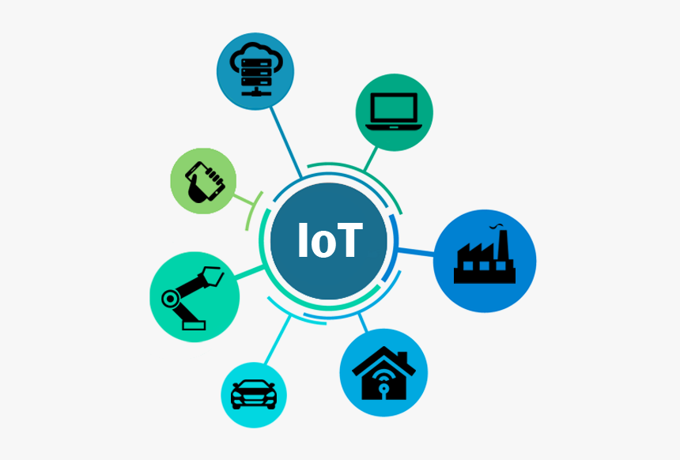
Usage of IoT
In the project we use the technology of IoT to connect all parts of the project to the internet to achieve the connection remotely
To collect the data from the sensors and then send it to the cloud server that we used
Why IoT technology? Because it is very common and is very fast and gives us a high speed for interacting and connecting the parts of our project together and synchronously

Slide 5
Objectives
Helping the nursing staff and institutions of health during the hardest time
Helping patients and their families by monitoring the patient's condition around the day
Reduce the health care cost and minimize the risk

Slide 6
System usability
Used in hospitals as a temporary nurse
Used in hardest times like covid-19 to avoid the infection
It can be used also in homes for patients that lie down in homes

Slide 7
System functionality
Collecting data
Monitoring the data
Patient’s case stability
Patient’s case instability

Slide 8
System Functionality
Collecting the data:
Using the temperature sensor and pulse rate sensor we collect the data from the patient, Sensors are connected to the patient around the day to collect the data and monitor it on the display screen all the time
Monitoring the data:
We monitor the data in two different ways:
First way On the display screen that is installed on the robot unit
Second way by the cloud server and its application

Slide 9
System Functionality
Patient’s Case stability:
No change in the patient’s condition parameters
The temperature parameter, and the pulse rate parameter are in normal case, so the doctor see that the patient does not need any medicines
The case still stable and no change in the system, so the robot unit does not take any action to move, all of that under the supervision of the doctor.

Slide 10
System Functionality
Patient’s case instability:
In the case of the changing in patient’s temperature or pulse rate
Doctor will send the order to robot unit, to reach the patient’s destination
The robot unit will move on the route that we constructed

Slide 11
System Functionality
The robot unit will deliver the medicine to the patient by opening box number 1 (temperature medicine box), then the robot unit waiting for a fixed time (1 minute) and after that will close box number 1 and start the move to the source again, waiting for a new order, all of that under supervision of the doctor.

Slide 12
System Definition
System consists of three main parts:
First part is the medicine or medico box
The second part is the robot unit
The route of the robot unit

Slide 13
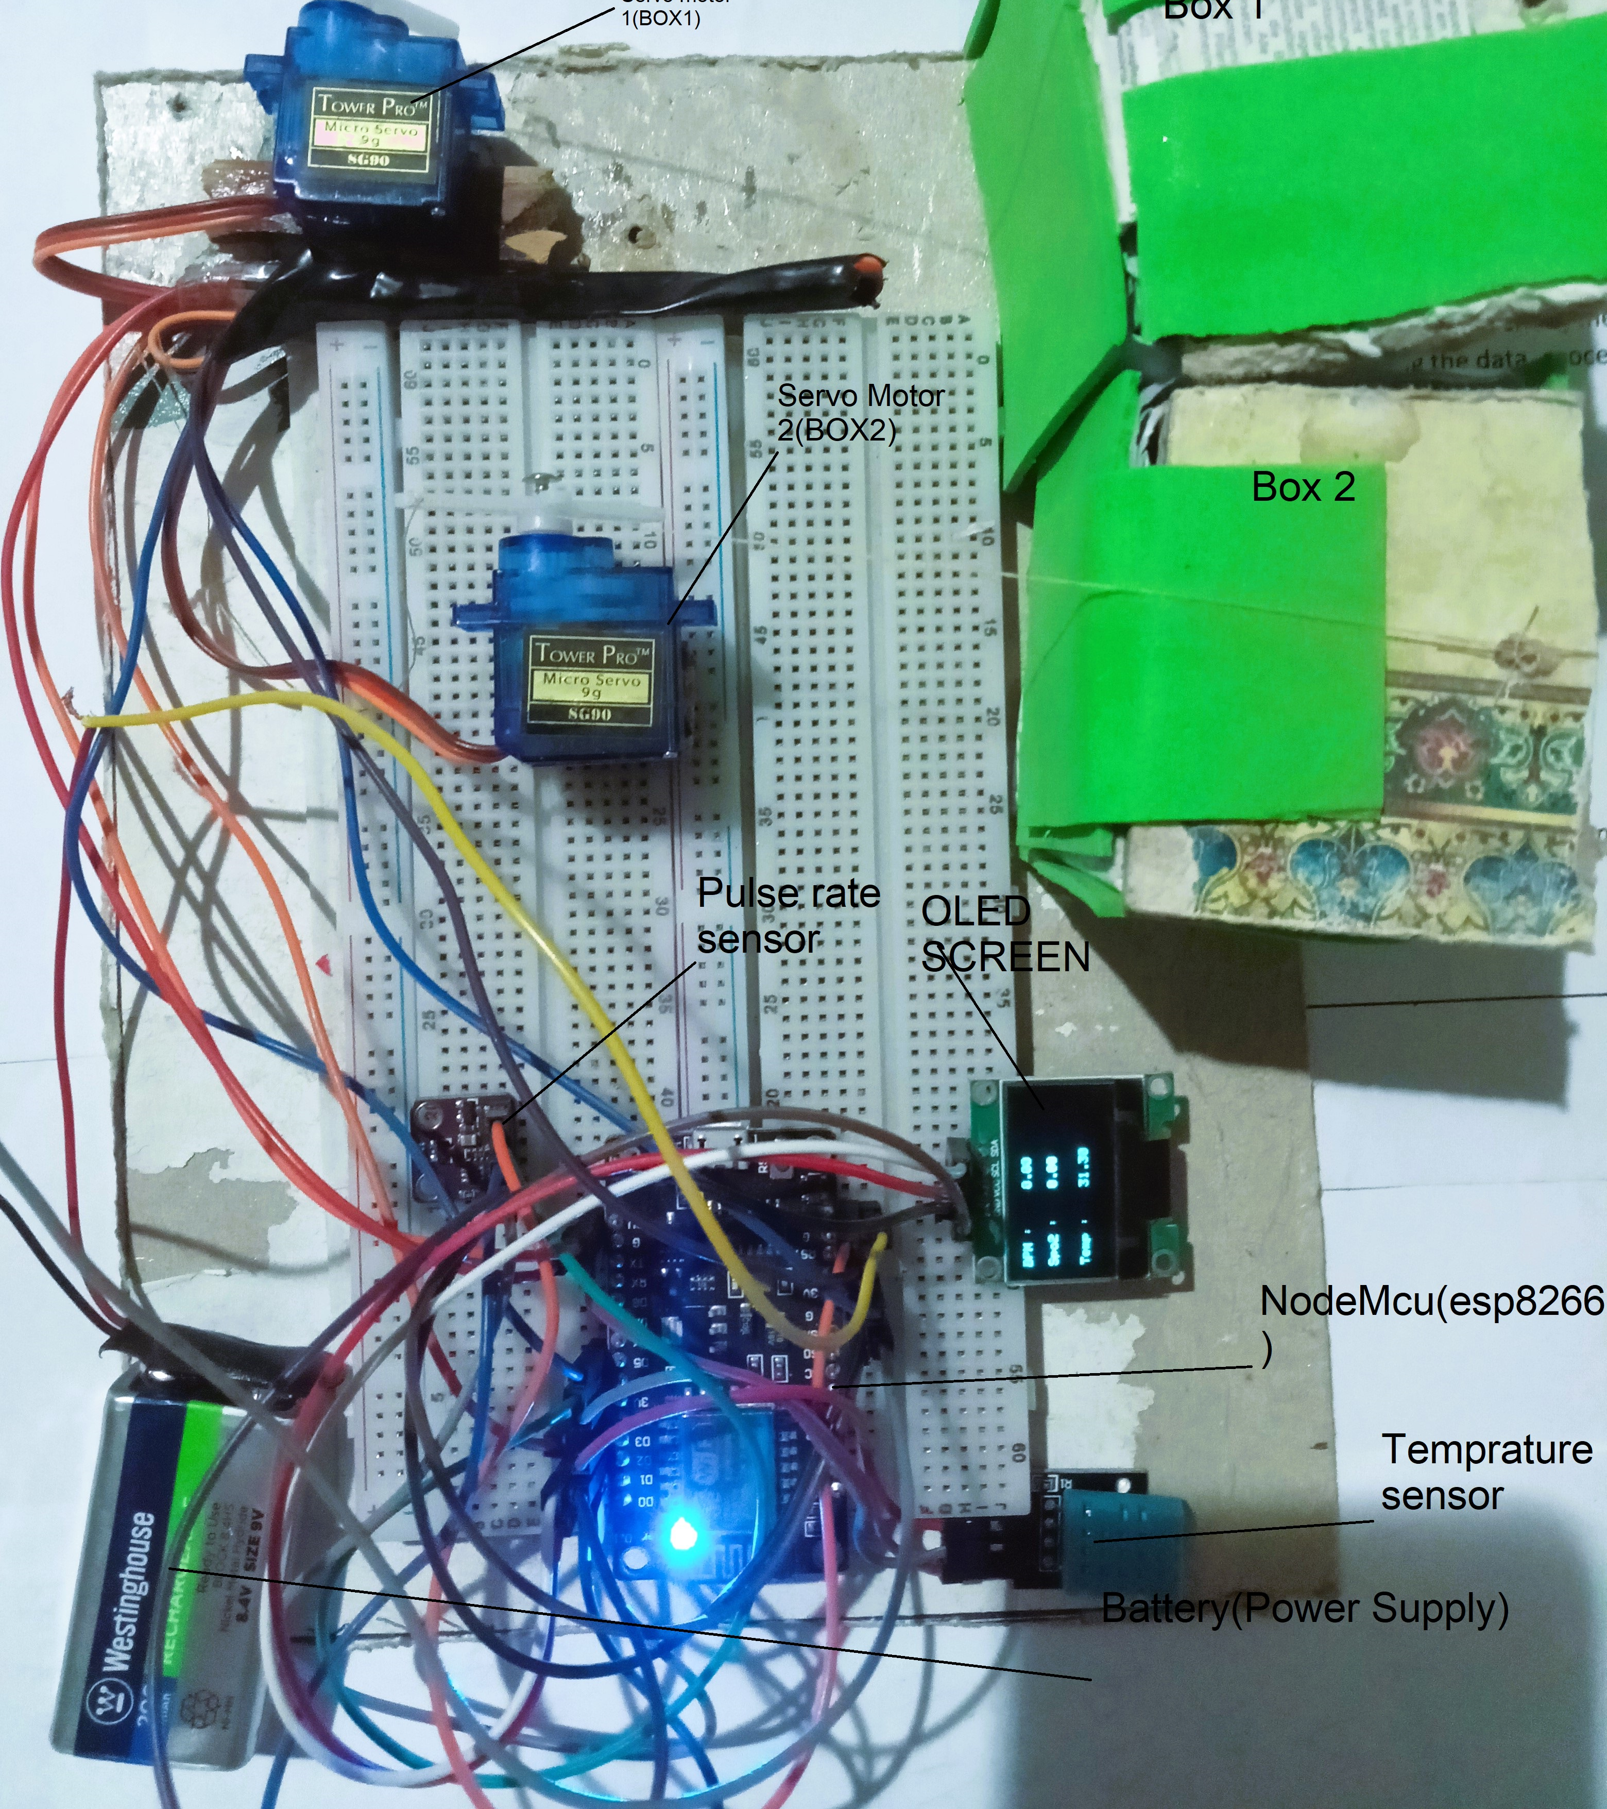
The Medico Box
The Medico Box part:
This part is responsible for sensing the data and monitoring it on the local level
This part consists of many components or devices as we see in the figure
The main component is the Node-MCU, this device provides the connection to the internet by the esp8266 module (Wi-Fi), sending the data to the cloud server.

Slide 14
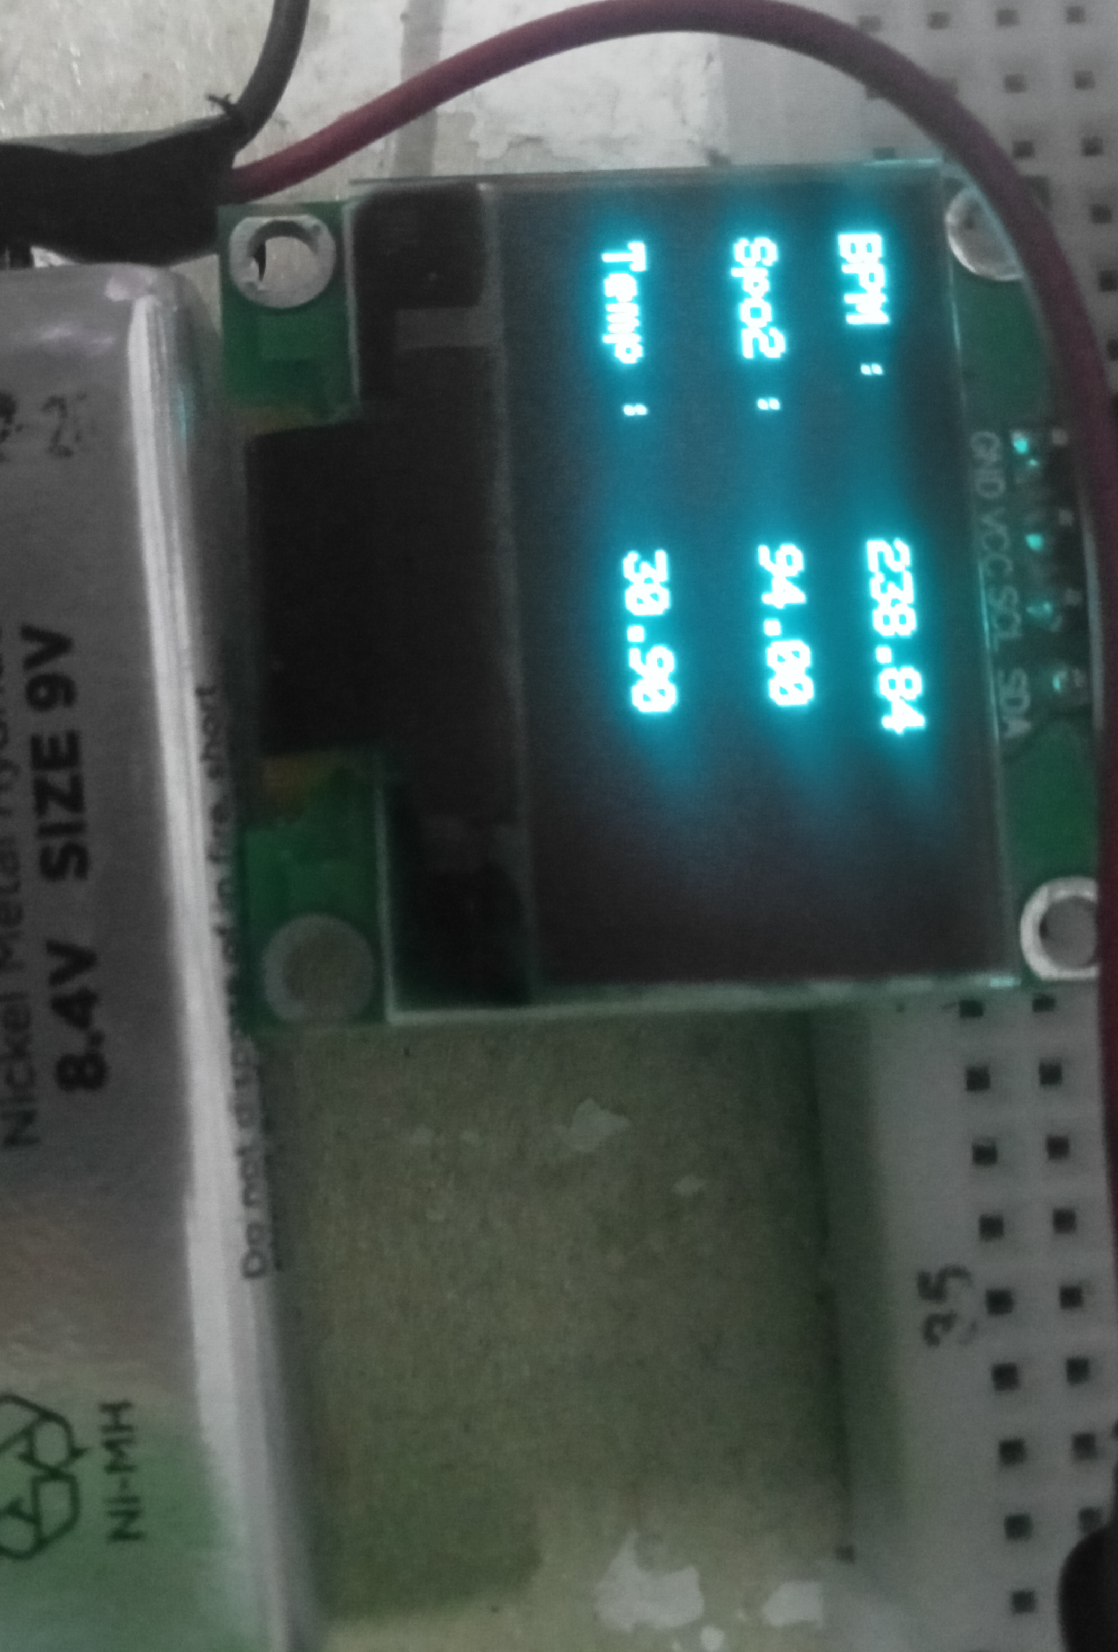
The Medico Box
The DHT sensor that senses the temperature parameter from the patient and the humidity.
The MAX30100 heart rate sensor senses the pulse rate parameter and oxygen infusion rate.
By collecting those parameters and following them to the esp8266, then the data will display on the OLED screen as we see.

Slide 15
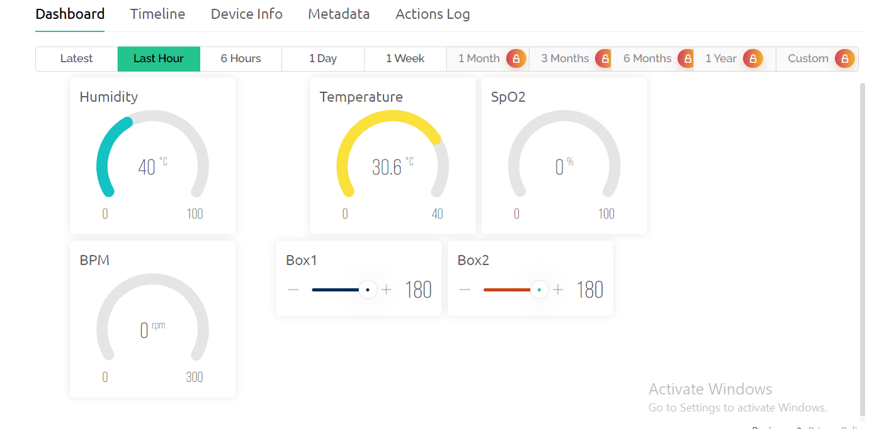
The Medico Box
We created an account on the platform and created template for the project
After the parameters are collected by the sensors and followed by the esp8266 then the parameters will send to the cloud server, We used this cloud server to store, process, and monitor the data this is (Blynk platform)

Slide 16
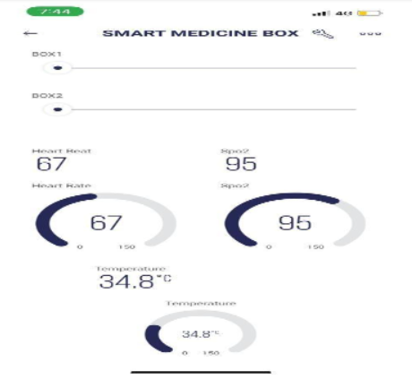
The Medico Box
Blynk Application:
There is an app belongs to the same platform (Blynk platform).
It will monitor the data of the patient, and gives full access to the doctor, so that he can see the patient’s condition all the time
The doctor gives the order in case of the changing of any patient’s condition parameters.

Slide 17
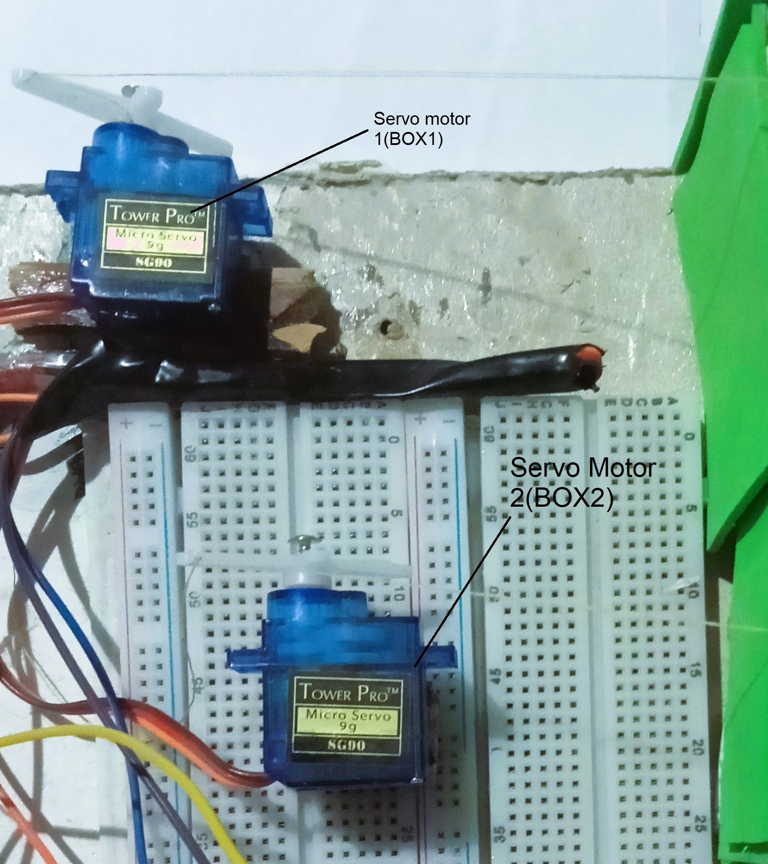
The Medico Box
The last part or component in the medico-boxes part is the medicine boxes themselves:
There are two boxes in the medico-boxes box1 for temperature medicine and box2 for the pulse rate medicine
So, the boxes are opened under the order of the doctor with needed medicine
These medicine boxes are opened by the servo motors that we used

Slide 18
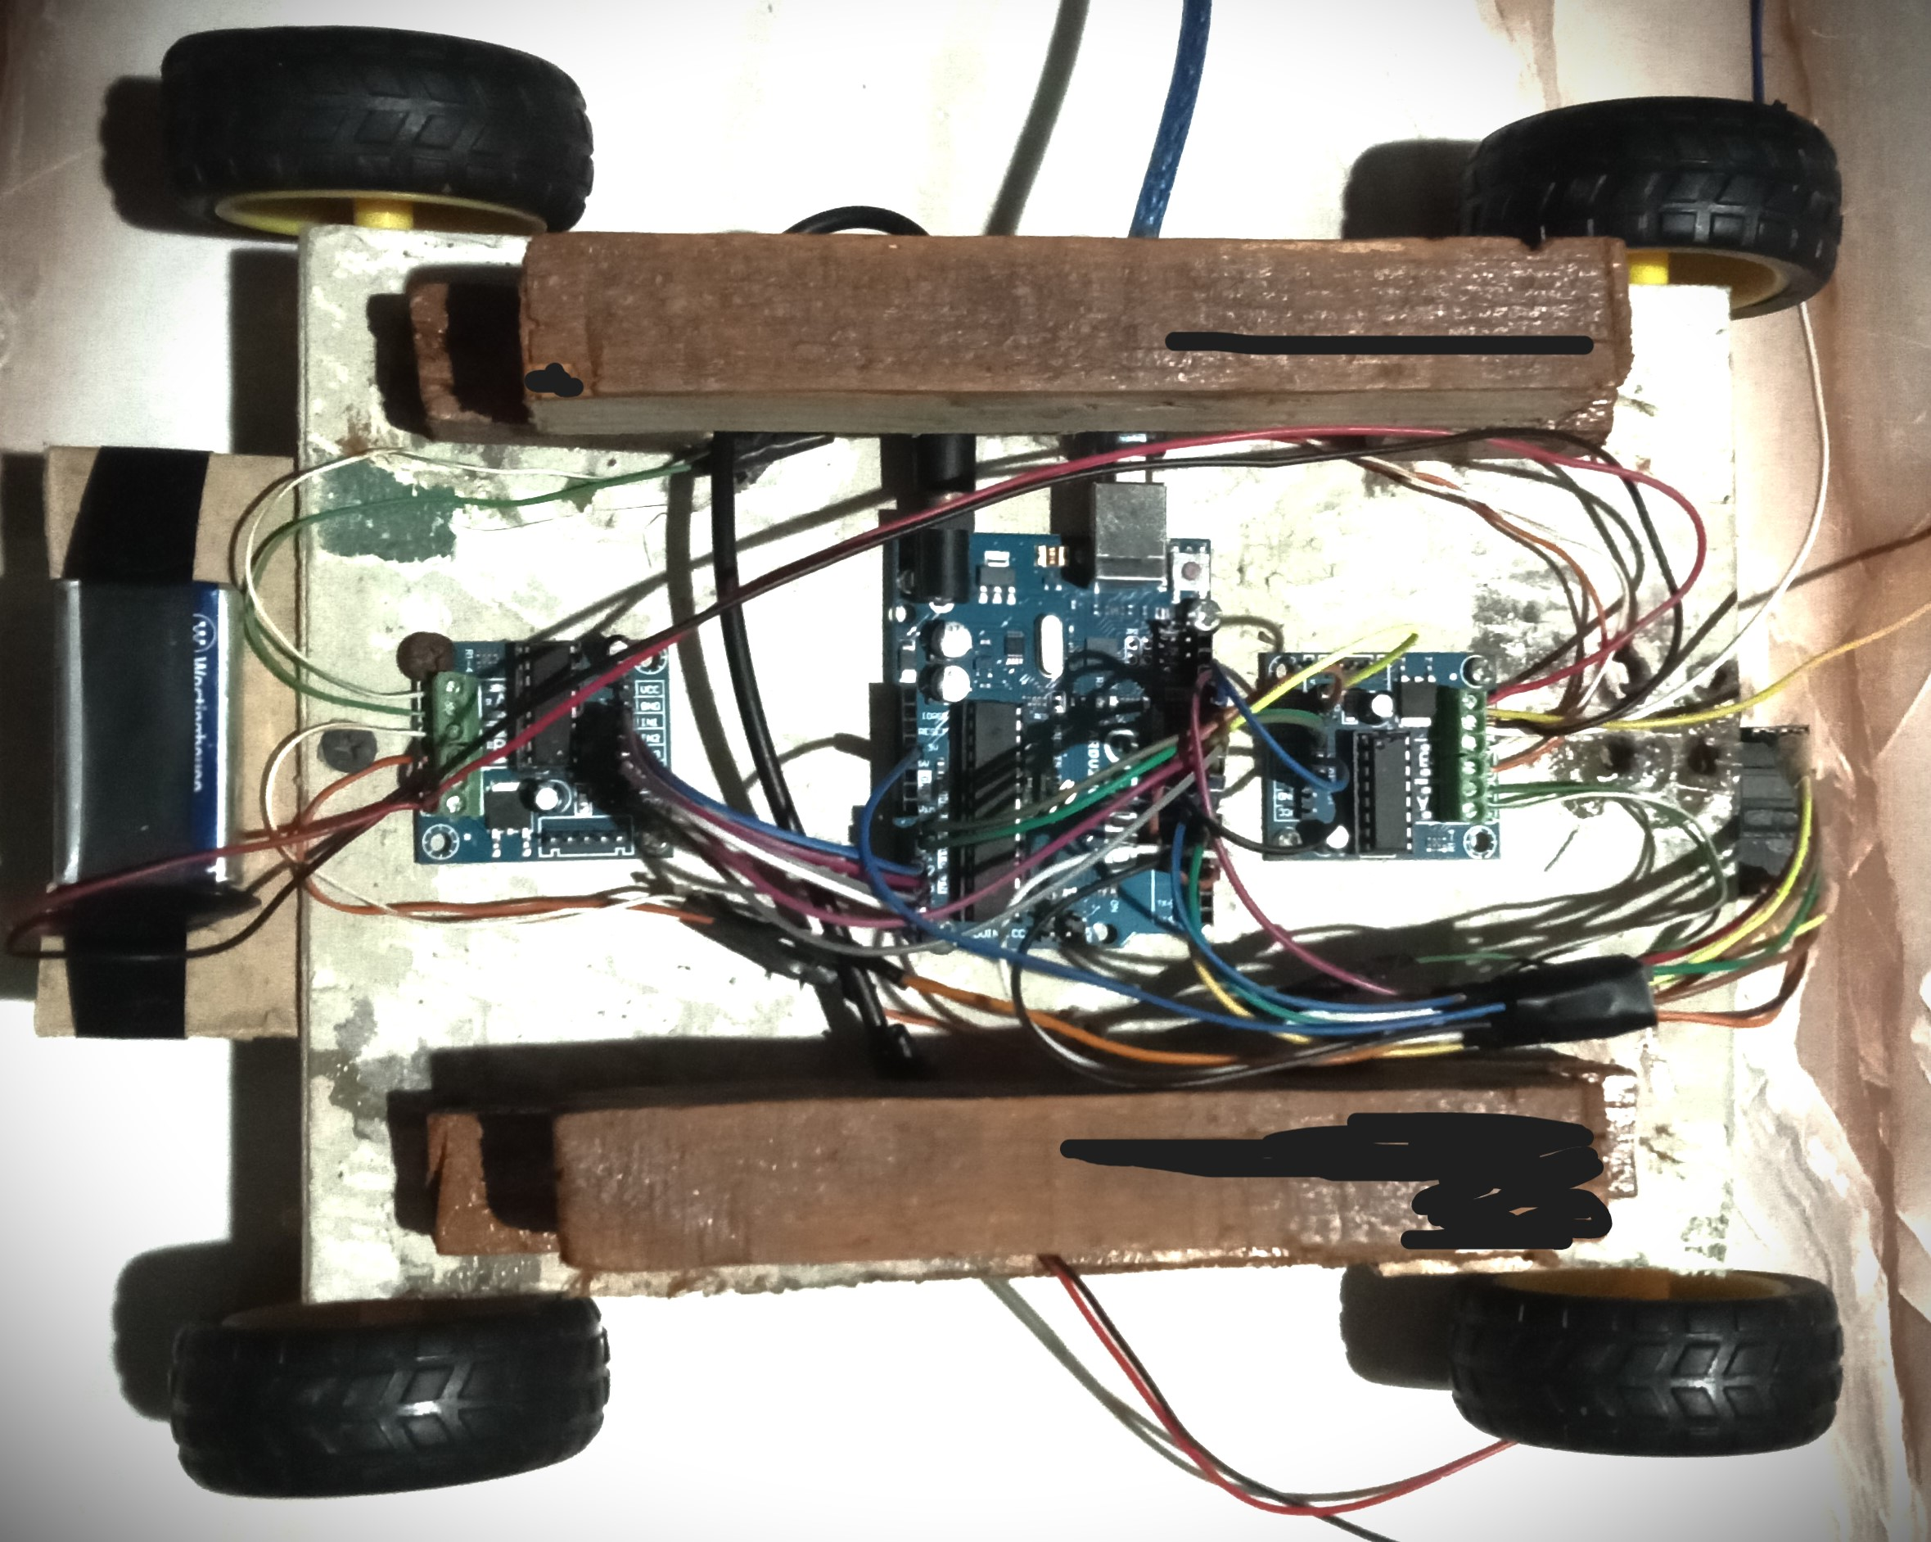
The Robot Unit part
The robot unit part is the part that is responsible for moving, so is the part that contains the part of the medico boxes
This part consists of the Arduino UNO, the color sensor, the battery, and the four dc motors, The h-bridge (L293D dual module)

Slide 19
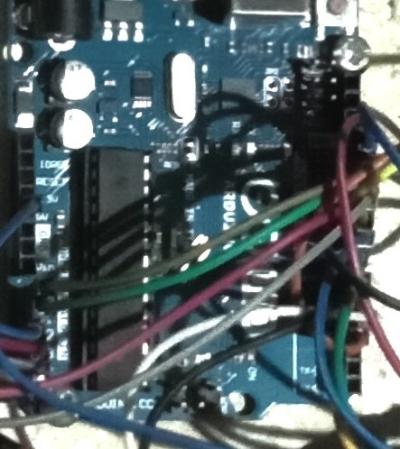
The Robot Unit part
The Arduino UNO is an important component in the robot unit part so without it there is no robot unit we use the Arduino to control and manage the relationship between all the parts

Slide 20
The robot unit
TCS 3200 color sensor that detects the basic three colors (RED, GREEN, BLUE), It reads ranges for the colors so we decide the readable color according to the reading ranges for this color by the color sensor
The color sensor is connected to the Arduino board and reads the color of the route and then the Arduino take an action according this readings

Slide 21
The robot unit
The color sensor mechanism: There are four electronic LEDs and the four LEDs are responsible for reading the color by filters installed on the sensor itself, so if we want to read RED color we put the RED color under the sensor, and gives us the range for the three basic colors (R, G, B), so we need the readings only of the three basic colors and from it we detect the other different colors that we used in the project

Slide 22
The robot unit
The H-bridge L293D dual module: to control the speed and the direction of the robot car we used the H-bridge dual module
Each two dc motor or wheels are connected to the H-bridge, so we used two H-bridge to control the speed and the direction of the robot car

Slide 23
The robot unit
The H-bridge dual module has six inputs and two outputs
Six inputs there are two of them for the direction so the wheel can be moved clockwise or anti-clockwise
The second two inputs for the second Dc motors
The last two inputs are used for the speed of the motors, the first one of them is used for the first one and the second is used for the second motor speed
Each of the two output is used for each motor.

Slide 24
The robot unit
DC motors with wheels: The robot unit contains fours dc motors with wheels, each motor has a wheel
So the DC motors and the wheels are responsible for moving forward and moving back by the direction pins clockwise and anti-clockwise so we adapt the suitable speed for moving forward or turning left

Slide 25
The robot unit (Block diagram)
The data on the color are collected from the color sensor, then this data are sent to the Arduino board to process it and after that, it will take action to move forward or turn left or stop according to this data
If the Arduino board decided to move, the order will reach the H-bridge in the proper direction and with a suitable speed and the order will go on the dc motors to move

Slide 26
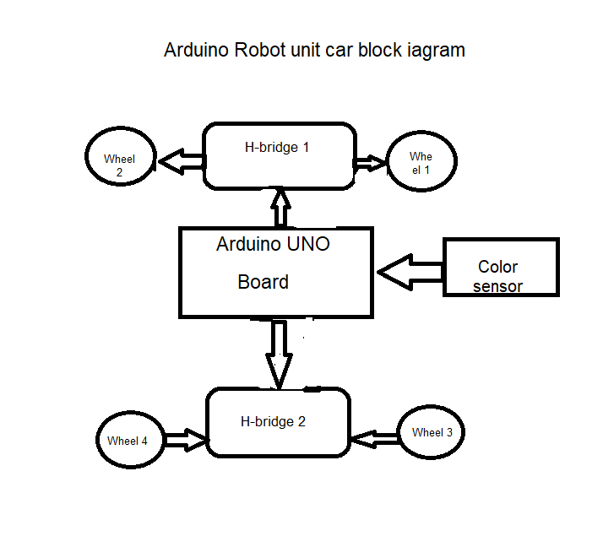
The robot unit (Block diagram)
Block diagram: the color sensor is connected to the Arduino UNO, The DC motors with wheels are connected to the H-bridge dual module, and The H-bridge is connected to the Arduino UNO by the direction and speed pins

Slide 27
The robot unit route
How the robot unit will move? It will be a colored track from the source to the destination.
If the order reached the robot unit to move the color sensor will read the colored track, The algorithm will be like that
If the readable color is red the car will move forward
If it is green in color the car will turn left, it is yellow it means the destination of the patient

Slide 28
The robot unit route
If the color sensor is black, then the robot unit will stop and which means it reached the source again.
So, the red color means to move forward, the green color means to turn left, and the yellow color means stop and give an alert to notify the patient to take the medicine, and one minute the car is ready to move forward again to reach the destination.
Finally, the black color means to the car reached the source again.

Slide 29
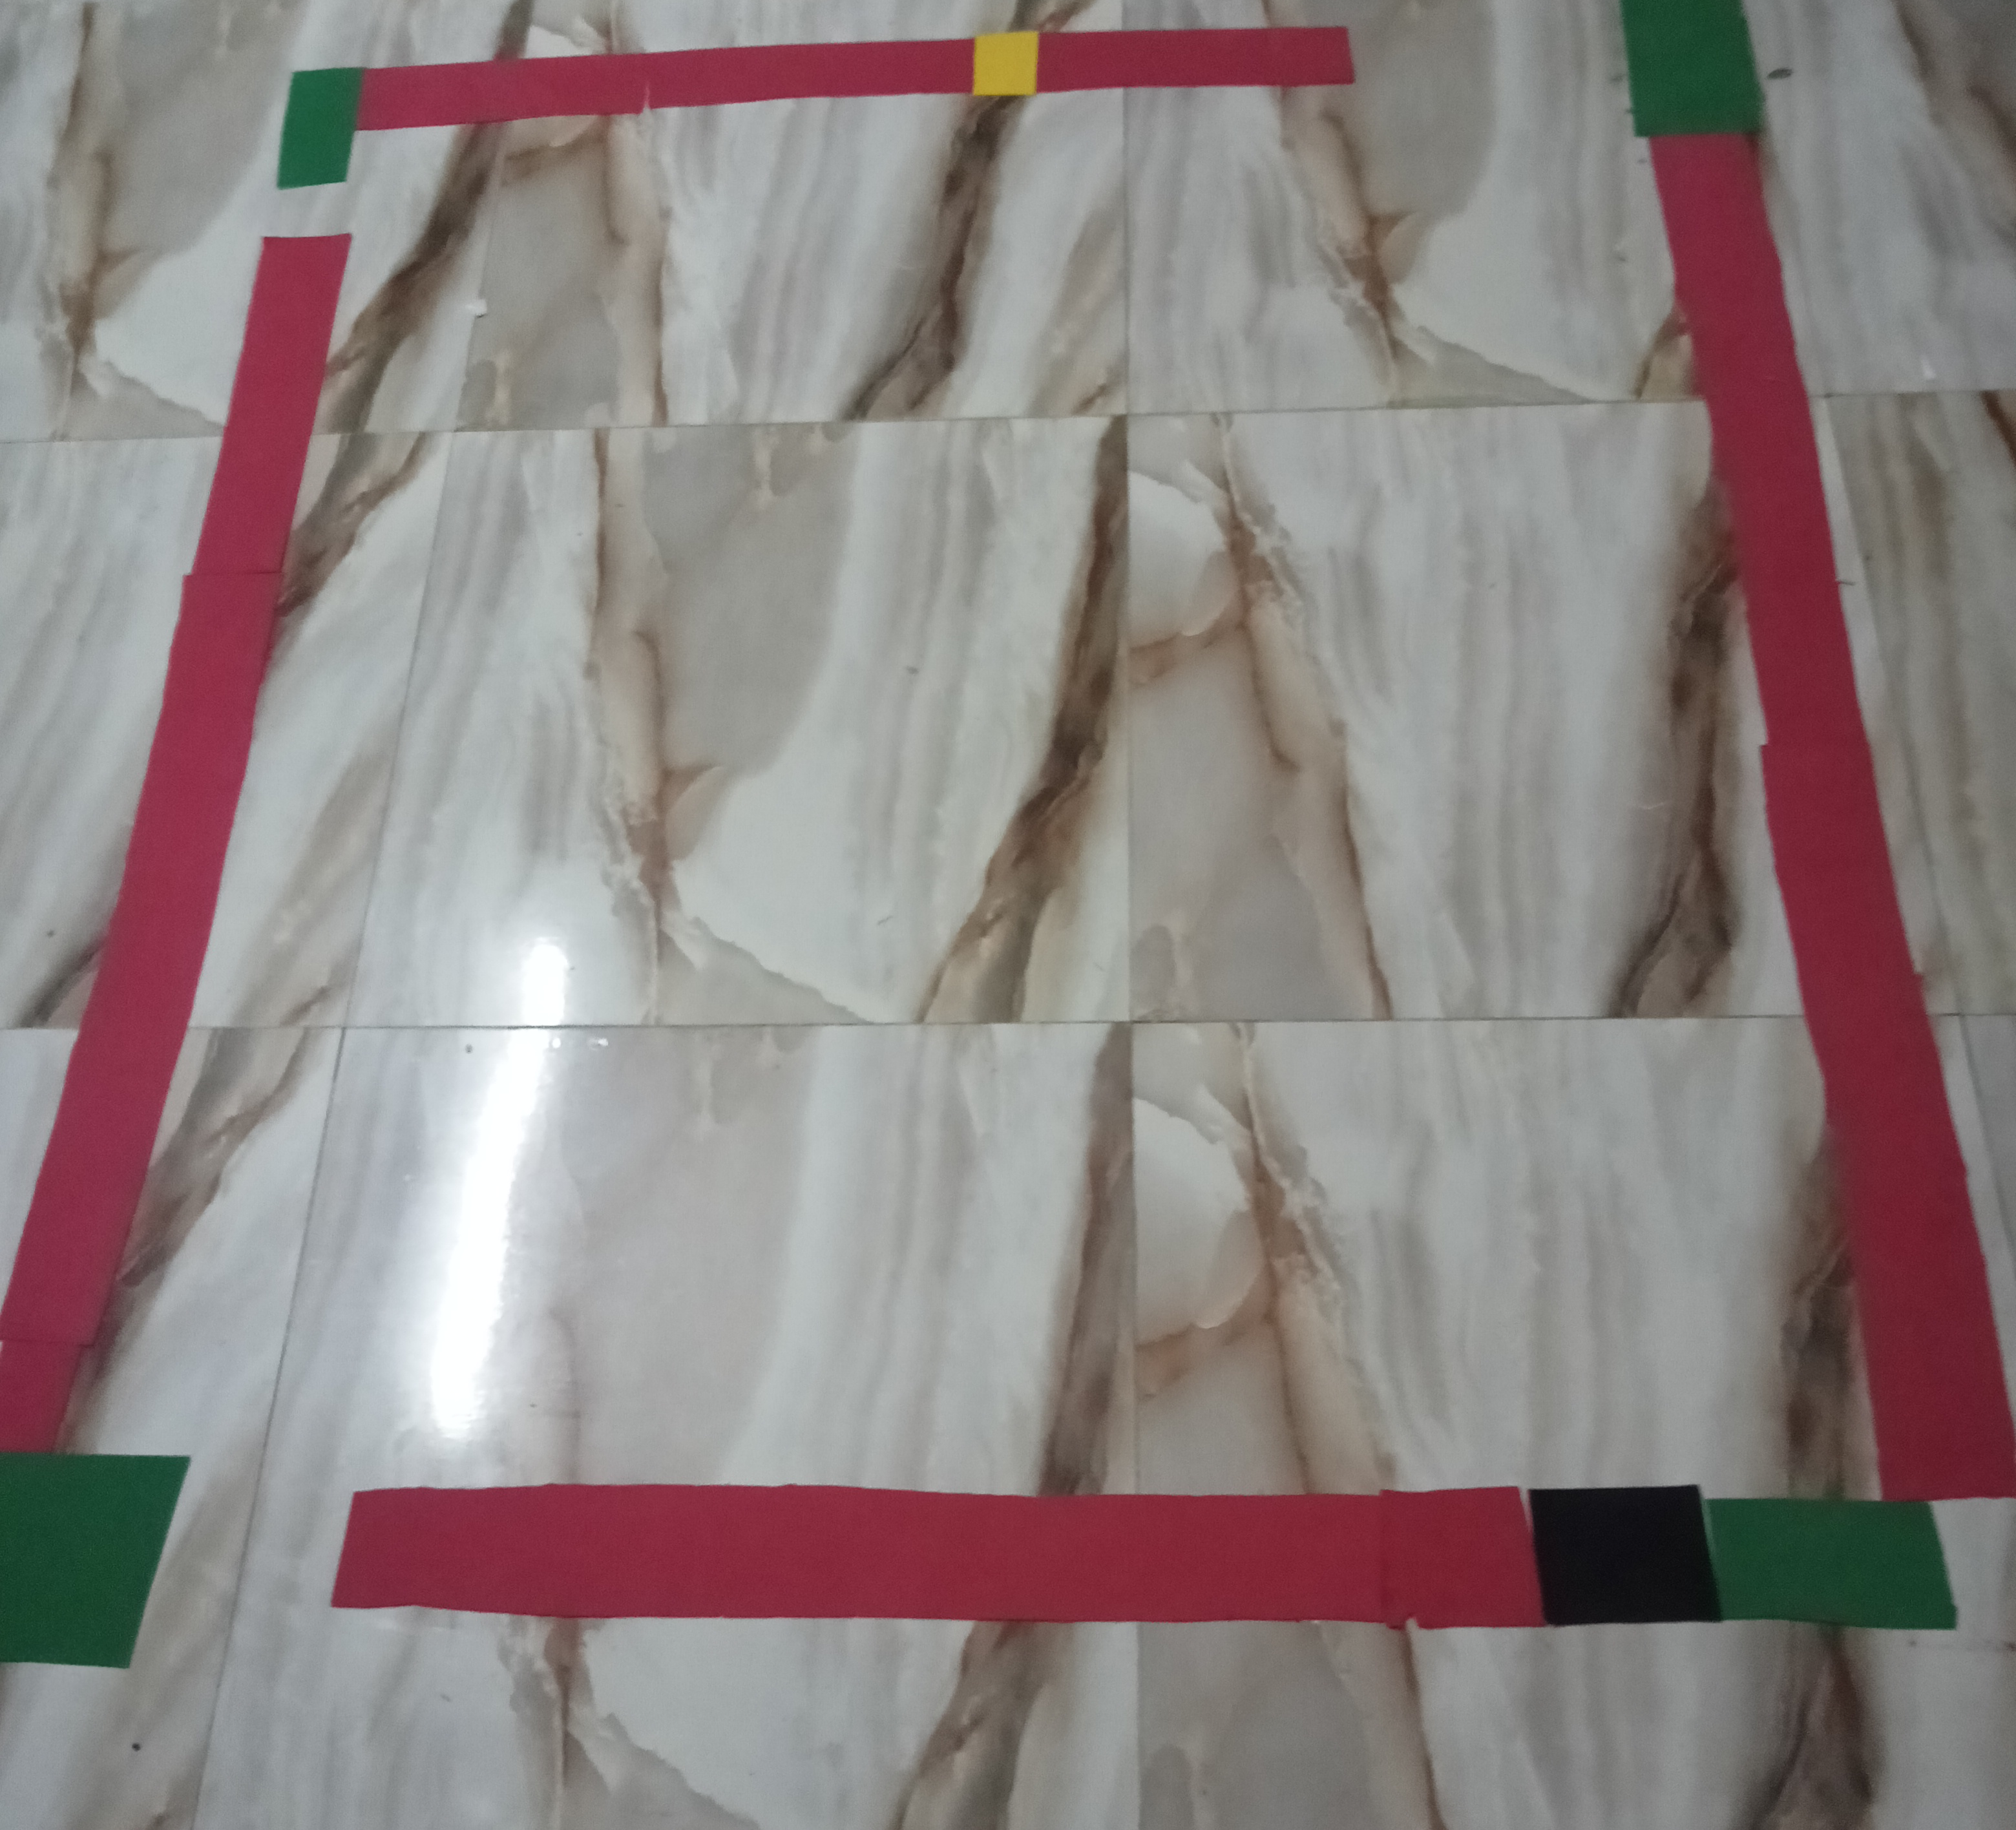
Illustrative Image
This is the colored track
Red, green, yellow, and black route

Slide 30
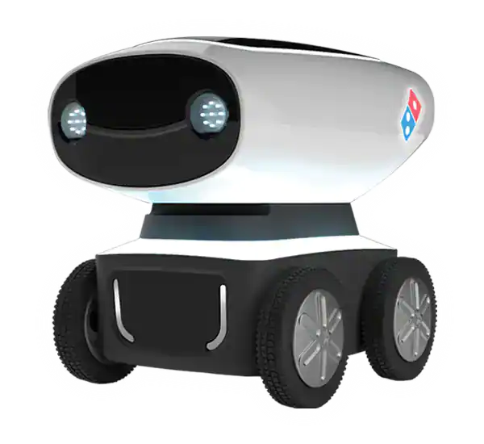
Conclusion
This project allows us to manage the patient’s case remotely, without any direct communication with the nursing staff or the healthcare staff so we saved the healthcare staff from any upcoming diseases.
It provides us with all information needed about the patient’s case.
Provides the medicines for the patient.

Slide 31

Future Works
In the future:
We can add more sensors for other parameters
Build the Whole body of the robot and add more features (Like system conversation between the patient and the robot)
Replace the color sensor with computer vision
Serve more than one patient

Slide 32
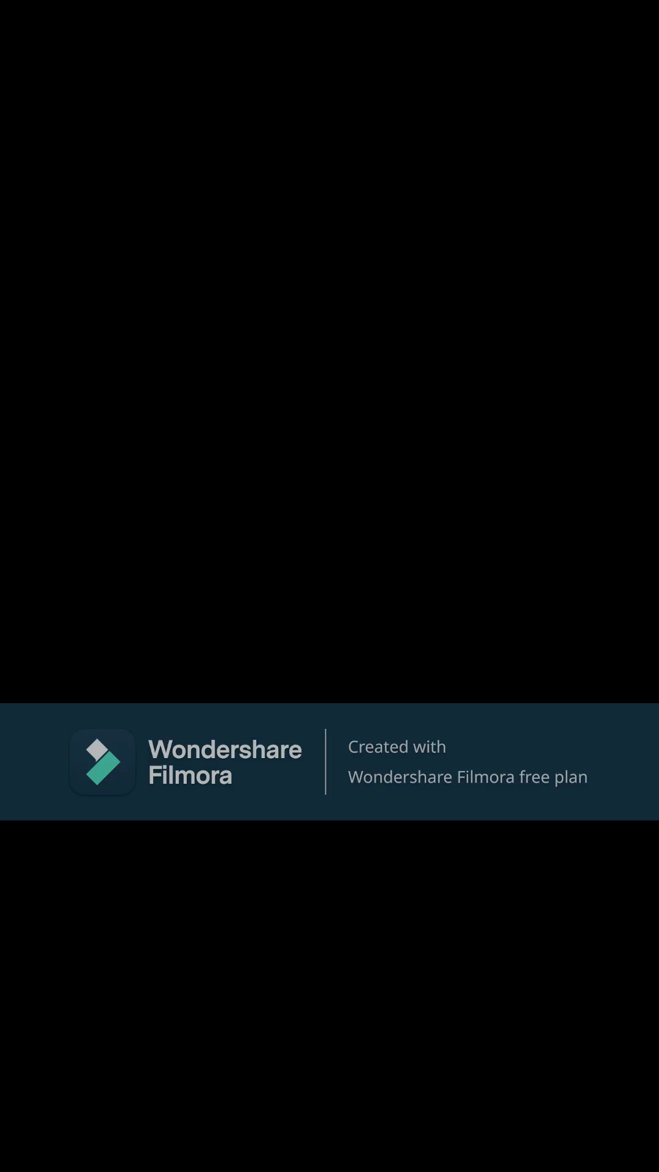
Practical video for the project
Final project product

